Slide 1
[Organisation] · PHASE C
Application
Communication
Fifty interfaces, forty-four unmanaged, and three applications touching thirty-four of them
20 batch files · 4 direct database reads · 6 managed
0.1 — Draft · September 2027

Slide 2
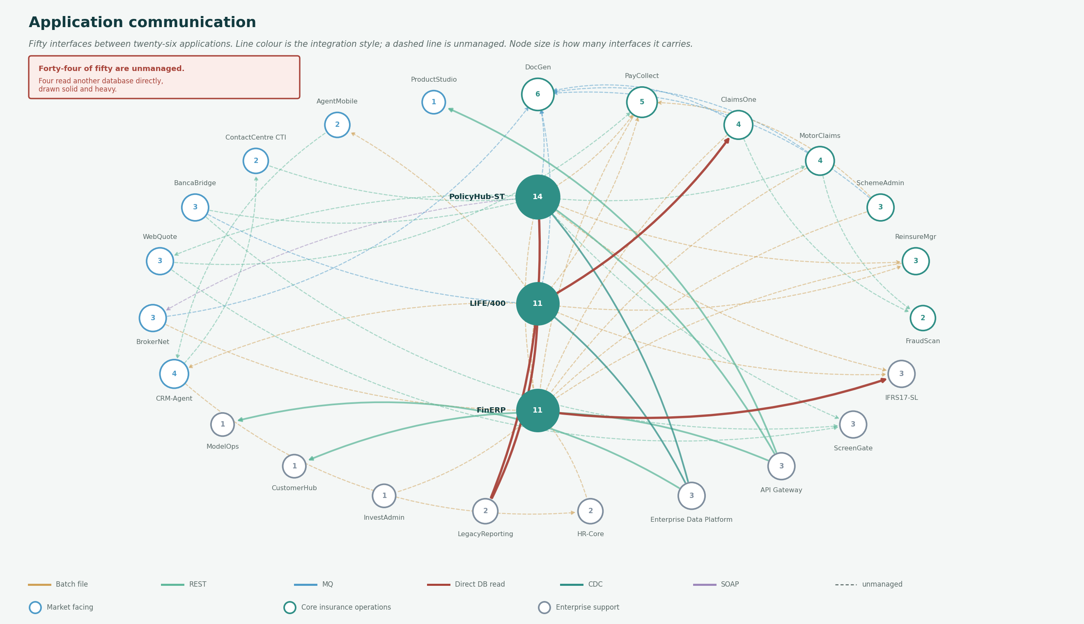
THE DIAGRAM
50 interfaces between 26 applications
Node size is interface count. Line colour is style, dashed is unmanaged, and solid heavy red is a direct database read.

Slide 3
ENCODING
How to read it
Five visual encodings, all computed from the interface register.
Node size and number
How many interfaces the application participates in.
PolicyHub-ST 14, LIFE/400 11, FinERP 11. Those three touch 34 of the 50 interfaces.
Line colour
The integration style: batch file, REST, MQ, direct database read, CDC or SOAP.
Twenty of fifty are batch files, which is where the customer-visible delay lives.
Dashed line
The interface is unmanaged: nothing authenticates, logs or versions it.
Forty-four of fifty. The six managed ones are four REST and two CDC.
Solid heavy red
A direct database read, drawn solid whatever its managed flag.
Four of them. They are not interfaces; they are one application depending on another's internal structure.
Node colour
The capability band the application mainly supports.
Market facing, core insurance operations or enterprise support.
A direct database read is drawn solid whatever its managed flag, because calling it unmanaged understates it.

Slide 4
THE FIRST THING TO REMOVE
Four direct database reads
One application reading another's tables. No contract, no version, and the owning team cannot change its schema safely.
IF-004
LIFE/400 → ClaimsOne
Real time
carries Policy
Claims reads policy tables directly.
IF-035
FinERP → IFRS17-SL
Monthly
carries Financial Transaction
Sub-ledger reconciliation.
IF-042
LegacyReporting → LIFE/400
Daily
carries Policy
Spreadsheet extract, to be retired.
IF-043
LegacyReporting → PolicyHub-ST
Daily
carries Policy
Spreadsheet extract, to be retired.
Two of the four come from LegacyReporting, which is marked Retire. Half the problem disappears with a decision already taken.

Slide 5
PROFILE
The shape of the estate
Fifty interfaces by style, direction and management.
By integration style
By direction
By management
Batch file
20
Outbound
29
Unmanaged
44
REST
16
Bidirectional
16
Managed
6
MQ
7
Inbound
5
Direct DB read
4
CDC
2
SOAP
1
Twenty-nine outbound against five inbound. Systems send when they are ready; the receiver cannot ask, it can only wait.

Slide 6
FINDINGS
What the topology shows
Three applications touch thirty-four of the fifty interfaces
PolicyHub-ST 14, LIFE/400 11, FinERP 11. Two of the three are Tier 1 and one of those is Legacy.
Sixty-eight per cent of the communication in the estate passes through three systems, and the roadmap treats each as one work package. An integration platform is not an optimisation here; it is what makes any of the three changeable.
The four direct database reads are the first thing to remove
LIFE/400 to ClaimsOne, FinERP to IFRS17-SL, and LegacyReporting to both LIFE/400 and PolicyHub-ST.
A direct read has no contract and no version, so the owning team cannot change its schema safely. Two of the four come from LegacyReporting, which is marked Retire, so half the problem disappears with a decision already taken.
Forty-four of fifty interfaces are unmanaged
Twenty batch files, twelve REST calls, seven MQ, four direct database reads and one SOAP.
Each names the entity it moves, so the exposure is known rather than suspected. Nothing authenticates, logs or versions any of them.
No pair of applications is connected twice
Fifty interfaces across fifty distinct pairs.
Worth noting because it is the usual sign of an estate that has grown by accident, and [Organisation] does not have it. The integration problem here is style and management, not duplication.
The estate pushes rather than pulls
Twenty-nine outbound against five inbound, with sixteen bidirectional.
Systems send when they are ready. That is why a claim settles on the overnight batch: the receiving system cannot ask, it can only wait.
No pair of applications is connected twice. The integration problem here is style and management, not duplication.

